Slide 1


ADMM
Distributed Control of Multi Agent Systems
Consensus in ADMM
Seminar 1
Blockchain
Smart Contract
“ Blockchains for Decentralized Optimization of Energy Resources in Microgrid Networks “
System Model
Solution
Published in:
2017 IEEE Conference on Control Technology and Applications (CCTA)
Blockchains for Decentralized Optimization of Energy Resources in Microgrid Networks
Mohammad Mahmoodian 810196391
Mohammad Mahmoodian

Slide 2


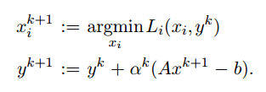


Main Problem
ADMM
Decentralized Lagrangian
Consensus in ADMM
Blockchain
Smart Contract
System Model
Solution
Augmented Lagrangian
Blockchains for Decentralized Optimization of Energy Resources in Microgrid Networks
Mohammad Mahmoodian
1/17

Slide 3

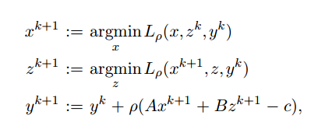



Alternating Direction Method of Multipliers (ADMM)
ADMM
Consensus in ADMM
Blockchain
Smart Contract
System Model
Solution
Primal residual at iteration k + 1
Blockchains for Decentralized Optimization of Energy Resources in Microgrid Networks
Dual residual at iteration k + 1
Stopping criteria
Mohammad Mahmoodian
2/17
Stopping criteria:

Slide 4



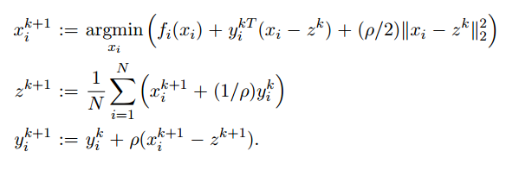
Global Variable Consensus Optimization
ADMM
Consensus in ADMM
Blockchain
Smart Contract
System Model
Solution
Updating
Blockchains for Decentralized Optimization of Energy Resources in Microgrid Networks
Mohammad Mahmoodian
3/17

Slide 5


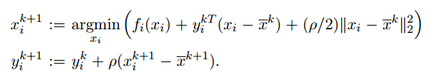


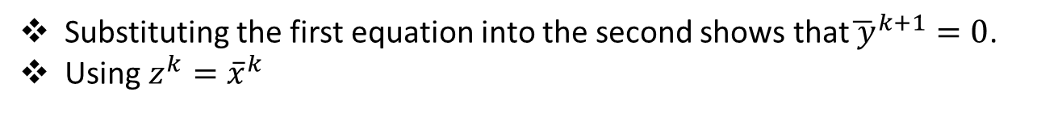
Average (over i = 1,...,N), the z-update can be written
ADMM
Consensus in ADMM
Blockchain
Smart Contract
Substituting the first equation into the second shows that${\overline{ y}}^{k+1}=0$.
Using $z^{k}={\overline{x}}^{k}$
System Model
Solution
Blockchains for Decentralized Optimization of Energy Resources in Microgrid Networks
Mohammad Mahmoodian
4/17

Slide 6


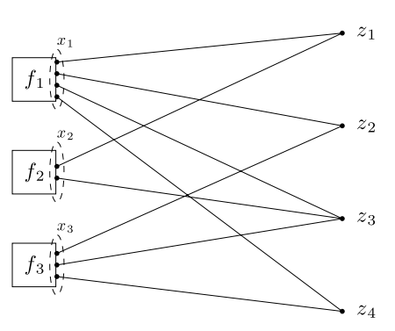
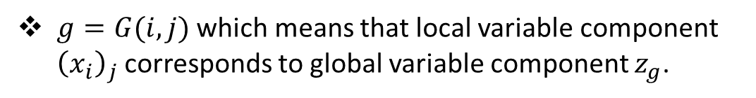
General Form Consensus
ADMM
Consensus in ADMM
$g=G(i,j)$ which means that local variable component ${\left(x_{i}\right)}_{j}$corresponds to global variable component $z_{g}$.
Blockchain
Smart Contract
System Model
Solution
Blockchains for Decentralized Optimization of Energy Resources in Microgrid Networks
Mohammad Mahmoodian
5/17

Slide 7
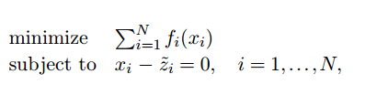
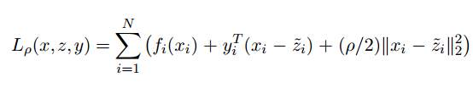
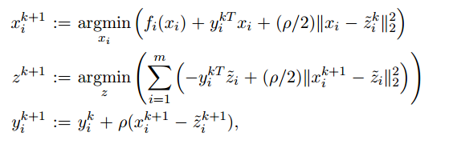


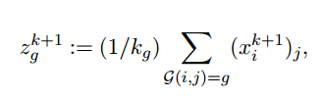

Problem
ADMM
Lagrangian
Consensus in ADMM
Blockchain
Smart Contract
System Model
Solution
$L_{ρ}$ is fully separable in its components
Blockchains for Decentralized Optimization of Energy Resources in Microgrid Networks
After the first iteration
Mohammad Mahmoodian
6/17

Slide 8
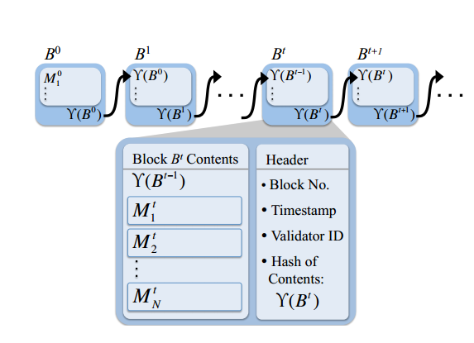
Blockchain
ADMM
Consensus in ADMM
Blockchain
Smart Contract
System Model
Solution
Blockchains for Decentralized Optimization of Energy Resources in Microgrid Networks
Mohammad Mahmoodian
7/17

Slide 9
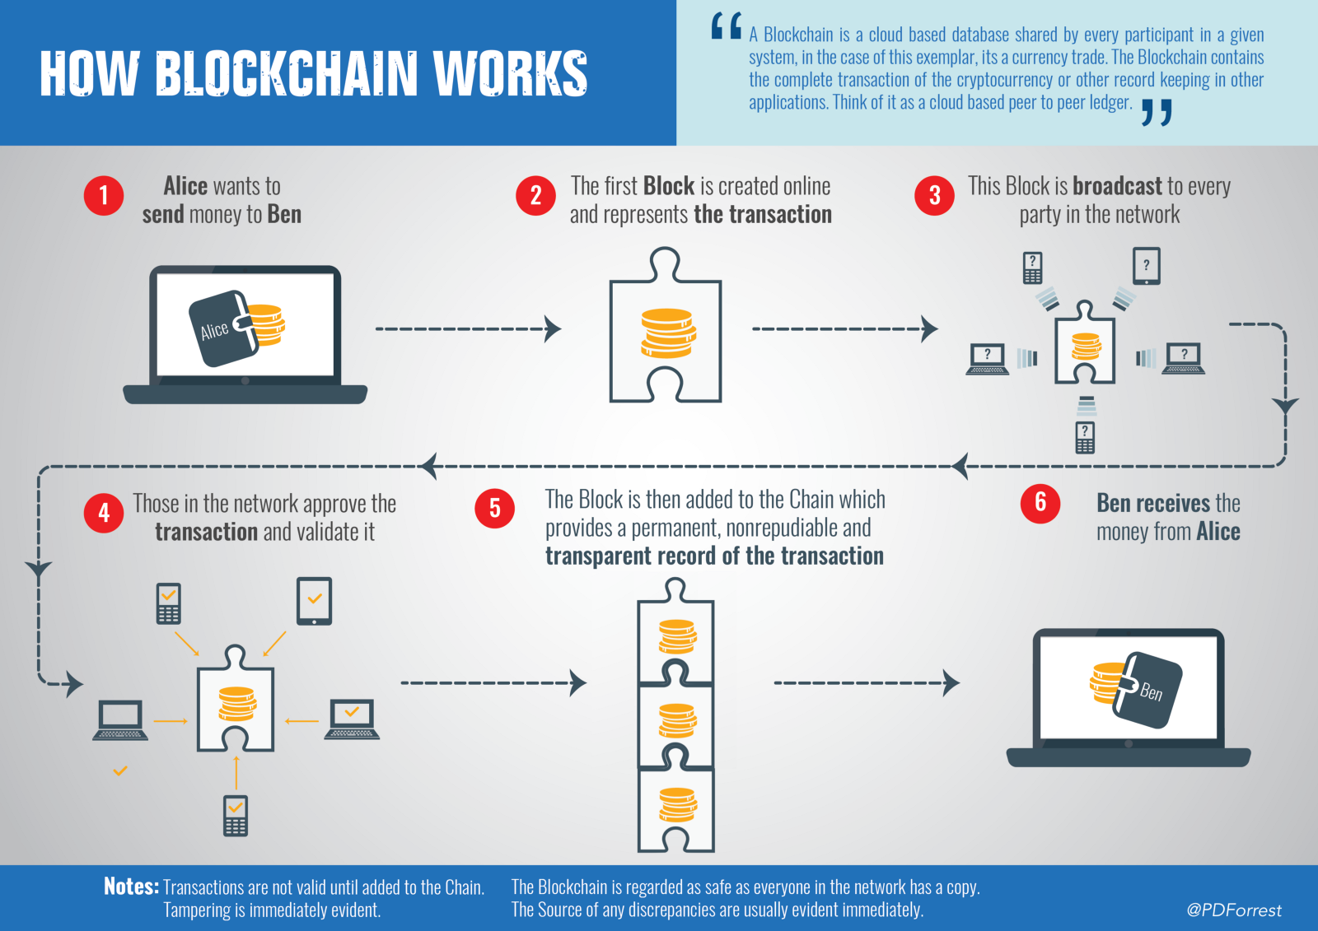
How Blockchain works
ADMM
Consensus in ADMM
Blockchain
Smart Contract
System Model
Solution
Blockchains for Decentralized Optimization of Energy Resources in Microgrid Networks
Mohammad Mahmoodian
8/17

Slide 10
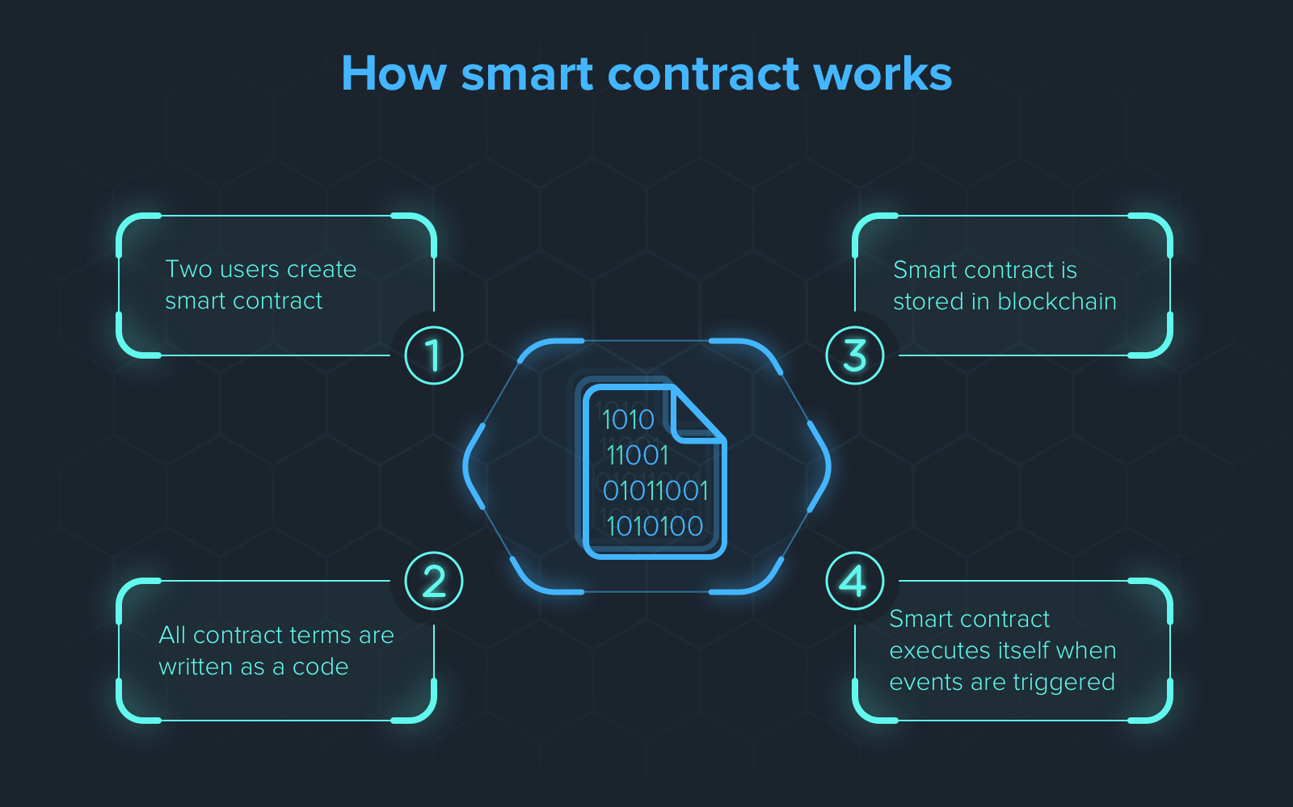
How smart contract works
ADMM
Consensus in ADMM
Blockchain
Smart Contract
System Model
Solution
Blockchains for Decentralized Optimization of Energy Resources in Microgrid Networks
Mohammad Mahmoodian
9/17

Slide 11
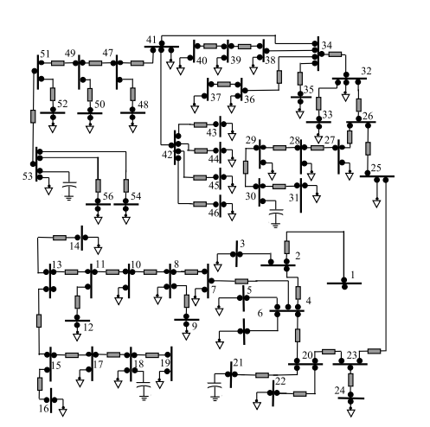
Power Flow
ADMM
Consensus in ADMM
Blockchain
Smart Contract
System Model
Solution
Blockchains for Decentralized Optimization of Energy Resources in Microgrid Networks
Problems in centralized methods:
monopoly incentive issues
Billing
Transparency
Security
Mohammad Mahmoodian
10/17

Slide 12
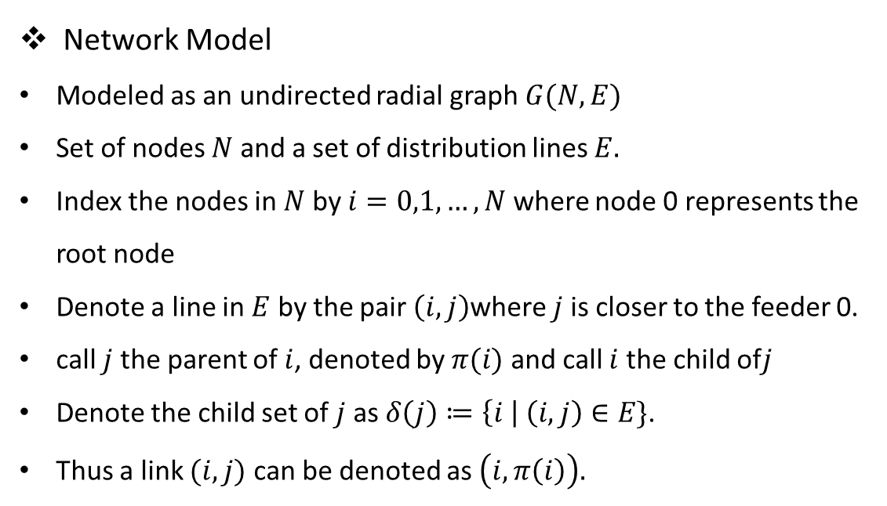
Network Model
Modeled as an undirected radial graph $G(N,E)$
Set of nodes $N$ and a set of distribution lines $E.$
Index the nodes in $N$ by $i=0,1,…,N$ where node 0 represents the root node
Denote a line in $E$ by the pair $\left(i, j\right)$where $j$ is closer to the feeder 0.
call $j$ the parent of $i$, denoted by $π(i)$ and call $i$ the child of$j$
Denote the child set of $j$ as $δ\left(j\right)≔\left\{i \right| \left(i,j\right)∈E\}$.
Thus a link $(i, j)$ can be denoted as $\left(i, π\left(i\right)\right).$
ADMM
Consensus in ADMM
Blockchain
Smart Contract
System Model
Solution
Blockchains for Decentralized Optimization of Energy Resources in Microgrid Networks
Mohammad Mahmoodian
11/17

Slide 13
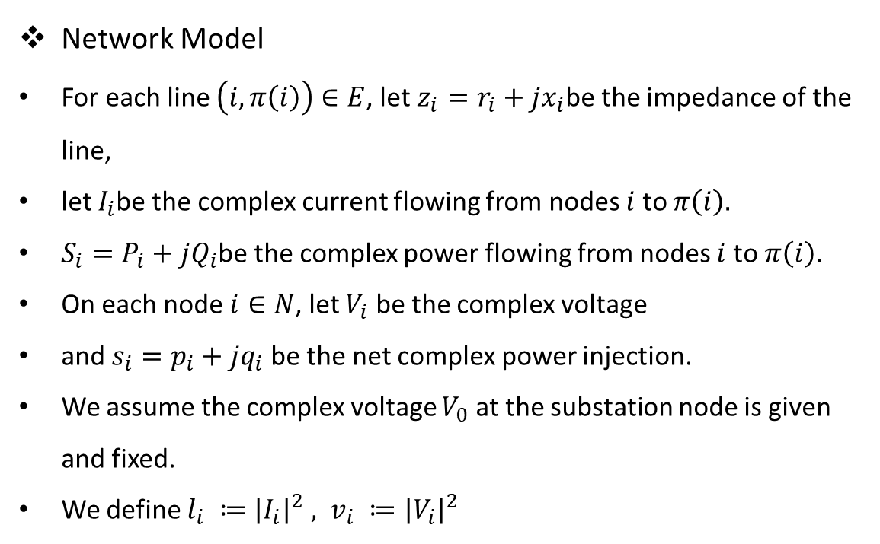
Network Model
For each line $\left(i, π\left(i\right)\right)∈E$, let $z_{i}=r_{i}+jx_{i}$be the impedance of the line,
let $I_{i}$be the complex current flowing from nodes $i$ to $π\left(i\right).$
$S_{i}=P_{i}+jQ_{i}$be the complex power flowing from nodes $i$ to$π\left(i\right).$
On each node $i∈N$, let $V_{i}$ be the complex voltage
and $s_{i}=p_{i}+jq_{i}$ be the net complex power injection.
We assume the complex voltage $V_{0}$ at the substation node is given and fixed.
We define $l_{i} ≔{\left|I_{i}\right|}^{2} , v_{i} ≔{\left|V_{i}\right|}^{2}$
ADMM
Consensus in ADMM
Blockchain
Smart Contract
System Model
Solution
Blockchains for Decentralized Optimization of Energy Resources in Microgrid Networks
Mohammad Mahmoodian
12/17

Slide 14
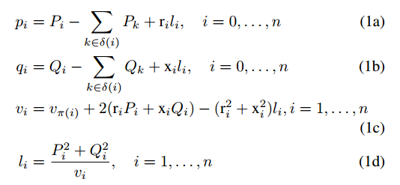

Constraints
ADMM
Consensus in ADMM
Blockchain
Smart Contract
System Model
The final equation (1d) forms a non-convex set. It is relaxed to an inequality, which yields a second-order cone constraint.
Solution
Blockchains for Decentralized Optimization of Energy Resources in Microgrid Networks
Mohammad Mahmoodian
13/17

Slide 15


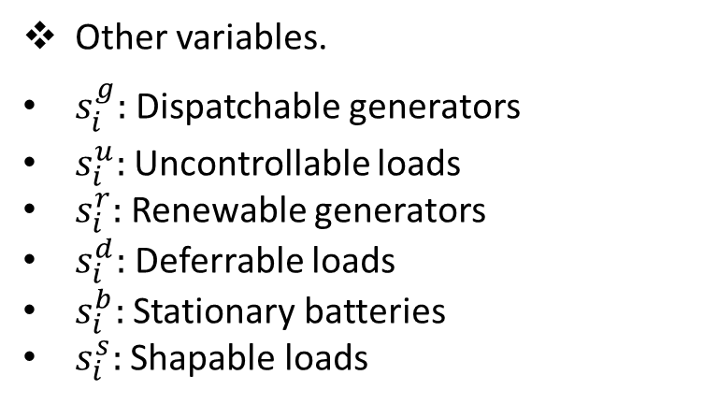
Other variables.
$s_{i}^{g}:$Dispatchable generators
$s_{i}^{u}:$Uncontrollable loads
$s_{i}^{r}:$Renewable generators
$s_{i}^{d}:$Deferrable loads
$s_{i}^{b}:$Stationary batteries
$s_{i}^{s}:$Shapable loads
ADMM
Consensus in ADMM
Blockchain
Smart Contract
System Model
The net complex injection at a node $i$ in period $t$ is:
Solution
Blockchains for Decentralized Optimization of Energy Resources in Microgrid Networks
Mohammad Mahmoodian
14/17

Slide 16



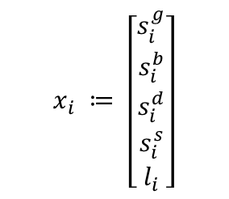
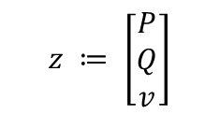
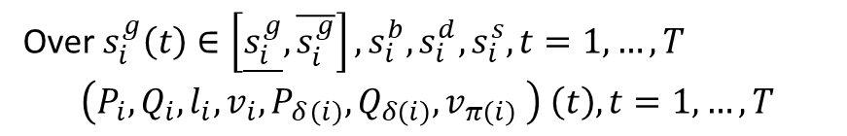
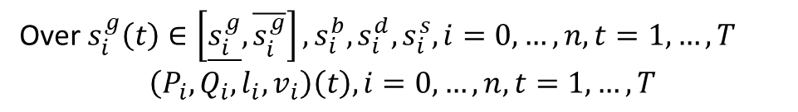
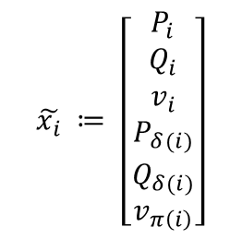
Objective
ADMM
Consensus in ADMM
Blockchain
Over $s_{i}^{g}\left(t\right)∈\left[\underline{s_{i}^{g}}, \overline{s_{i}^{g}}\right],s_{i}^{b}, s_{i}^{d}, s_{i}^{s}, i=0,…, n, t=1,…,T$
$$\left(P_{i}, Q_{i}, l_{i}, v_{i}\right)\left(t\right), i=0,…, n, t=1,…,T$$
Smart Contract
System Model
Apply ADMM
Solution
Over $s_{i}^{g}\left(t\right)∈\left[\underline{s_{i}^{g}}, \overline{s_{i}^{g}}\right], s_{i}^{b}, s_{i}^{d}, s_{i}^{s}, t=1,…,T$
$$\left(P_{i}, Q_{i}, l_{i}, v_{i},P_{δ\left(i\right)}, Q_{δ\left(i\right)}, v_{π\left(i\right)} \right) \left(t\right), t=1,…, T$$
Blockchains for Decentralized Optimization of Energy Resources in Microgrid Networks
$$\tilde{x_{i}} ≔ \left[\begin{aligned}P_{i} \\ Q_{i} \\ v_{i} \\ P_{δ(i)} \\ Q_{δ(i)} \\ v_{π\left(i\right)}\end{aligned}\right]$$
$$x_{i} ≔ \left[\begin{aligned}s_{i}^{g} \\ s_{i}^{b} \\ s_{i}^{d} \\ s_{i}^{s} \\ l_{i}\end{aligned}\right]$$
$$z ≔ \left[\begin{aligned}P \\ Q \\ v\end{aligned}\right]$$
Mohammad Mahmoodian
15/17

Slide 17







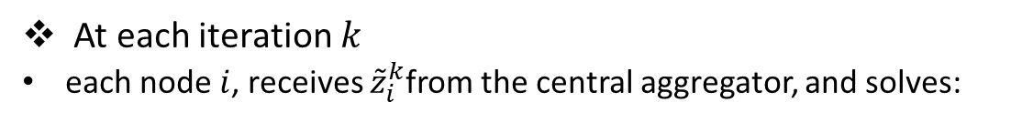
At each iteration $k$
each node $i$, receives ${\tilde{z}}_{i}^{k}$from the central aggregator, and solves:
ADMM
Consensus in ADMM
Over $x_{i}$and ${\tilde{x}}_{i}$
Blockchain
Then sends its new ${\tilde{x}}_{i}^{k+1}$ to the central aggregator, who updates $z_{g}^{k+1}$:
Smart Contract
System Model
Solution
Aggregator updates Lagrange multipliers($ξ_{i}$):
Blockchains for Decentralized Optimization of Energy Resources in Microgrid Networks
Stopping criteria:
Mohammad Mahmoodian
16/17

Slide 18
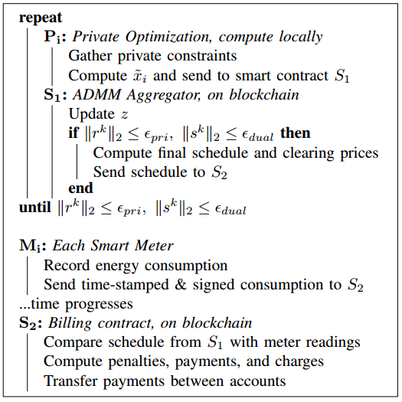
Decentralized structure of the problem and programming
ADMM
Consensus in ADMM
Blockchain
Smart Contract
System Model
Solution
Blockchains for Decentralized Optimization of Energy Resources in Microgrid Networks
Mohammad Mahmoodian
17/17

Slide 19
ADMM
THANK YOU
Consensus in ADMM
Blockchain
Smart Contract
and
System Model
Any Question?
Solution
Blockchains for Decentralized Optimization of Energy Resources in Microgrid Networks
Mohammad Mahmoodian

